Slide 1
2022 Canadian Chemical Crystallography Workshop
(Post?) Pandemic Edition!!

Slide 2
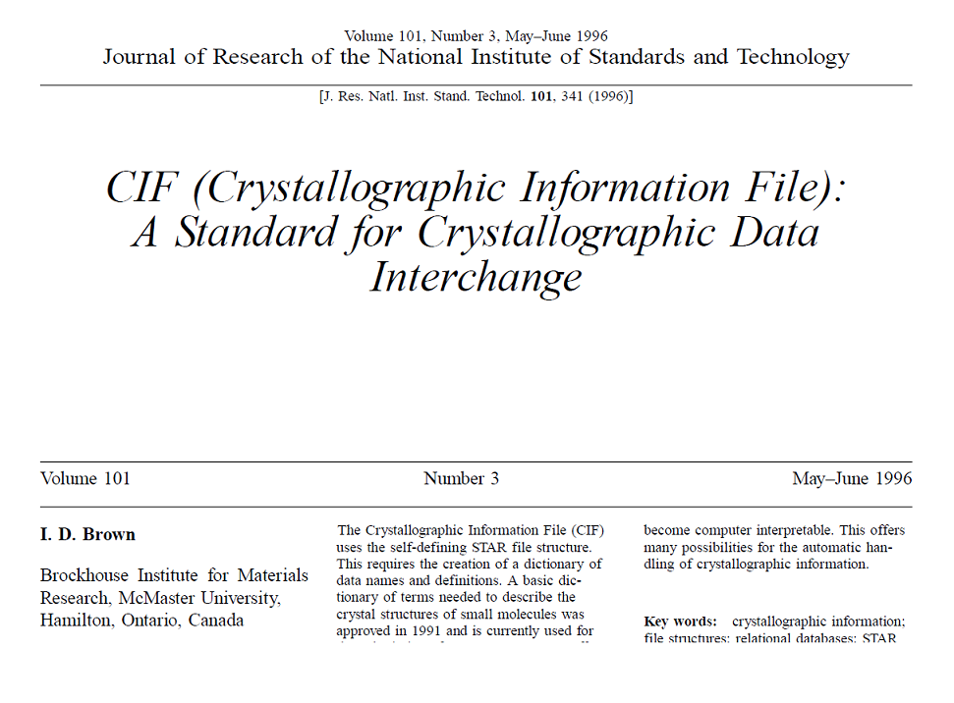
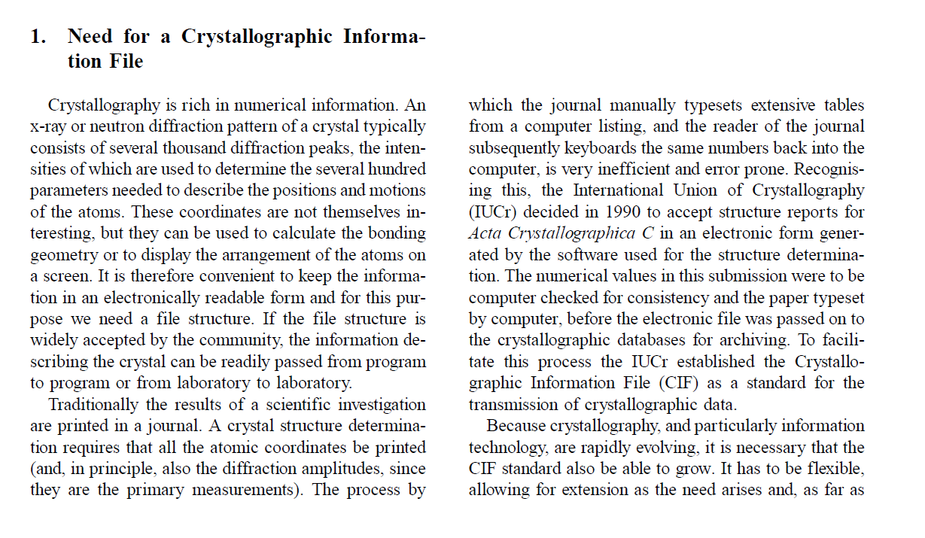
L12. Crystallographic Information Framework and Validation: The CIF file and checkCIF

Slide 3
L12. Crystallographic Information Framework and Validation: The CIF file and checkCIF

Slide 4

L12. Crystallographic Information Framework and Validation: The CIF file and checkCIF
First introduced in 1990’s as a means of archiving and distributing structural information, as well as a means of formatting and publishing the same structural information (see Acta Crystallographica papers).

Slide 5
Crystal structures are essentially a collection of 3D atomic coordinates (and their ADPs) that define the asymmetric unit, combined with symmetry elements associated with a space group that we use to build the lattice. They are ideally suited to electronic handling and archiving.

Slide 6
Crystal structures are essentially a collection of 3D atomic coordinates that define the asymmetric unit, combined with symmetry elements associated with a space group that we use to build the lattice. They are ideally suited to electronic handling and archiving.
“The crystallographic community needed a common file structure that all crystallographic applications would recognize…the file structure had to be more than just a storage place for archiving the results of crystallographic determinations, it had to be a crystallographic language that could be used by computers to explore the wealth of information on crystal chemistry that was even then accumulating in electronic databases.” Brown and McMahon, Acta Cryst. (2002), B58, 317-324

Slide 7
What is a CIF?

Slide 8
What is a CIF?
A CIF is simply a text file!
Feel free to edit…

Slide 9
What is a CIF?
The CIF contains the most current information about your crystal (coordinates, ADPs) and the associated refinement data (R-values, residual electron density). It should also contain a complete a copy of the .res file and a list of structure factors. Most refinement packages (Olex2, etc) can generate new .ins and .hkl files directly from the CIF.
The CIF contains fields to be filled in with information about the crystal, its structure, and the refinement results. ShelXL (Crystals? Olex2.refine?) will fill in as many fields related to the refinement as possible, Olex2 (Shelxle? Crystals?) will fill in fields related to the crystal, the X-ray source, diffractometer, etc.
CIFs are generated at the completion of a refinement cycle when the command ‘ACTA’ is included in your .ins instruction file. In Olex2, if the ACTA tab is selected a new CIF will overwrite the previous CIF after each cycle.

Slide 10
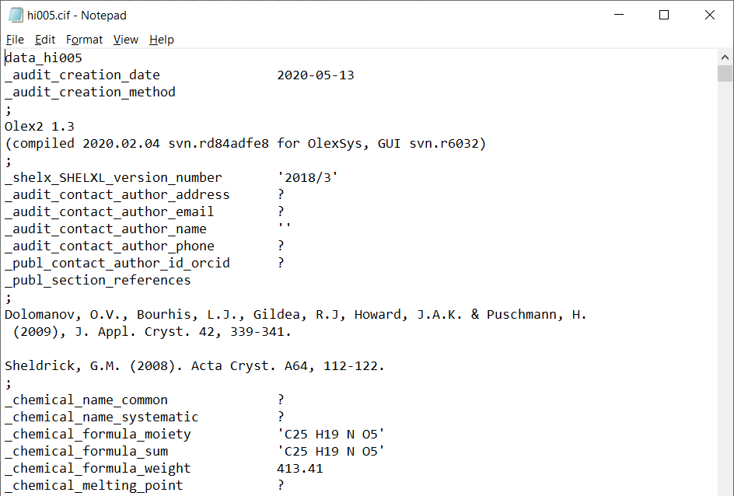
What information is found in a CIF?
Software and versions used to compile the CIF.
Chemical formula input by the user.

Slide 11
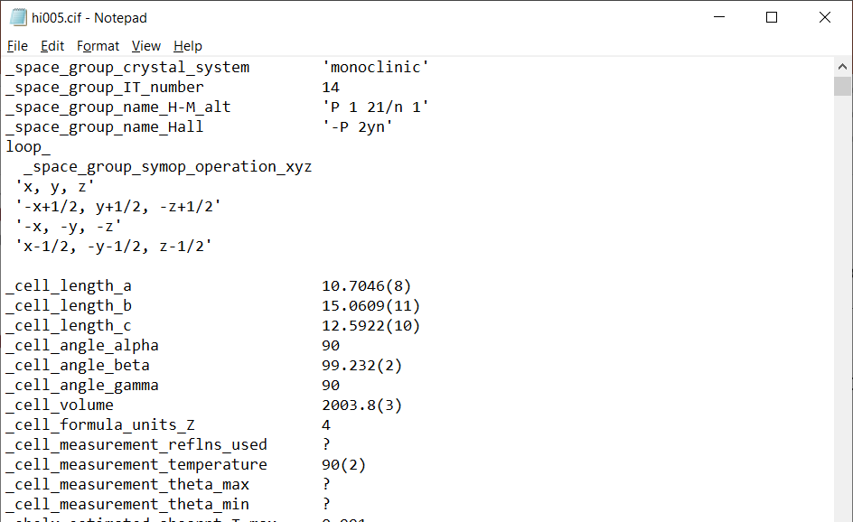
What information is found in a CIF?
Information about the space group.
Symmetry equivalent positions as defined by the space group.
Unit cell parameters

Slide 12
What information is found in a CIF?
Information about the space group.
This (in addition to fractional coordinates) is all that’s required to ‘build’ the crystal.

Slide 13
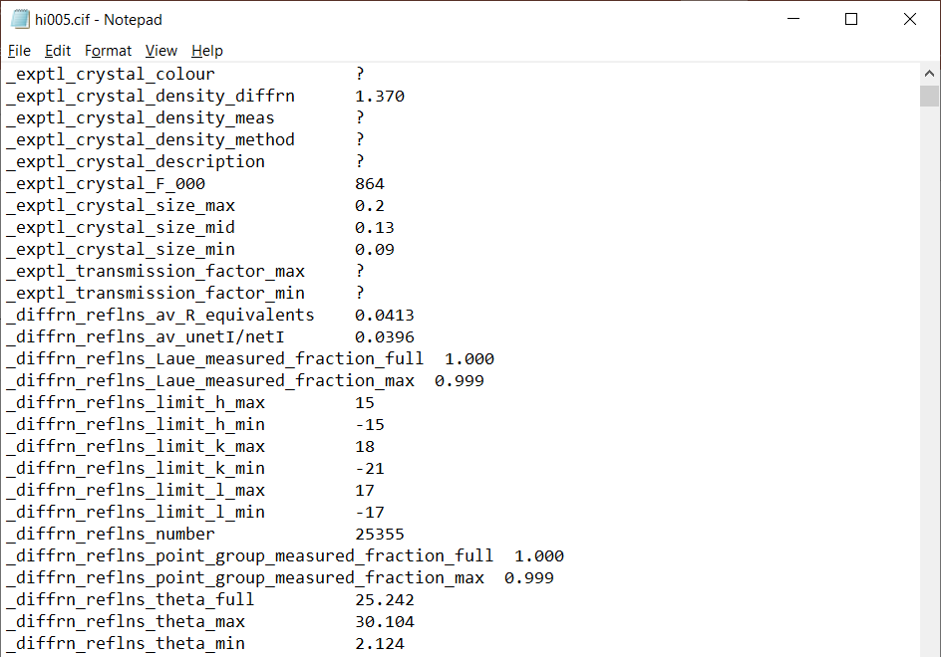
What information is found in a CIF?
Crystal stuff!
Data stuff!

Slide 14
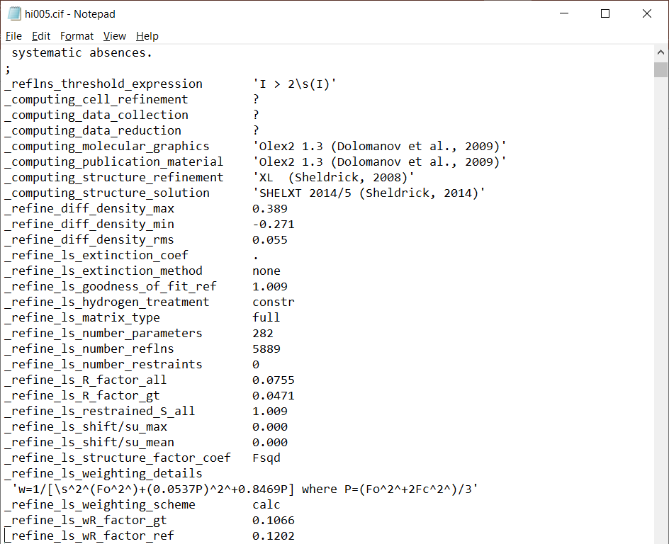
What information is found in a CIF?
Refinement results!

Slide 15
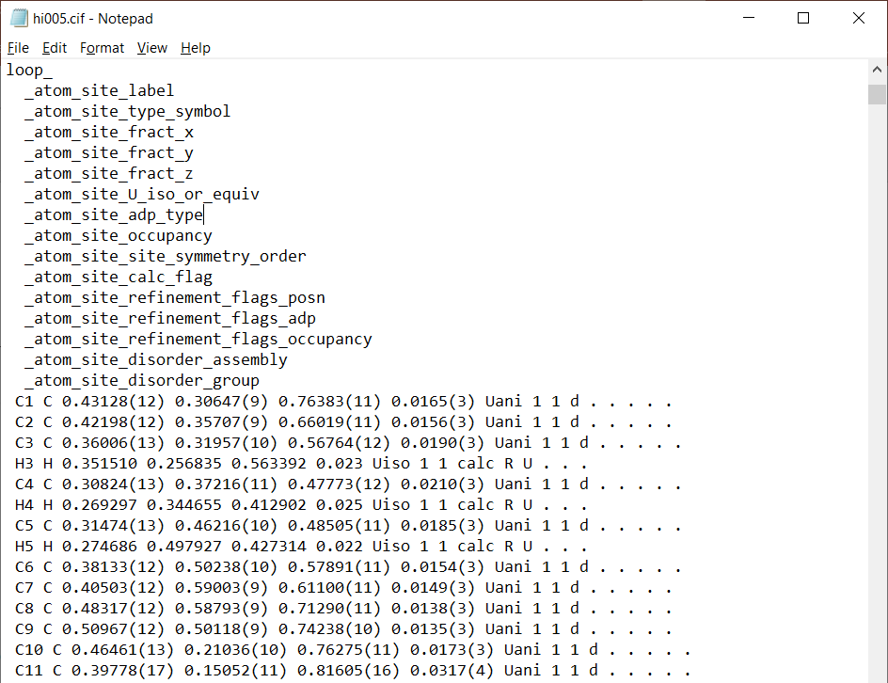
What information is found in a CIF?
Fractional coordinates for each atom! Your structure!

Slide 16
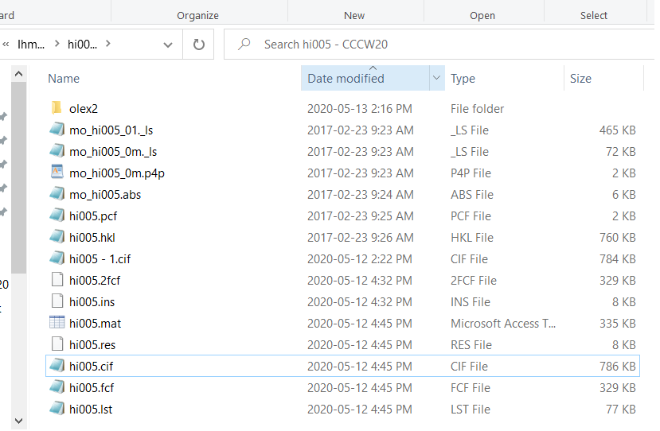
What information is found in a CIF?

Slide 17
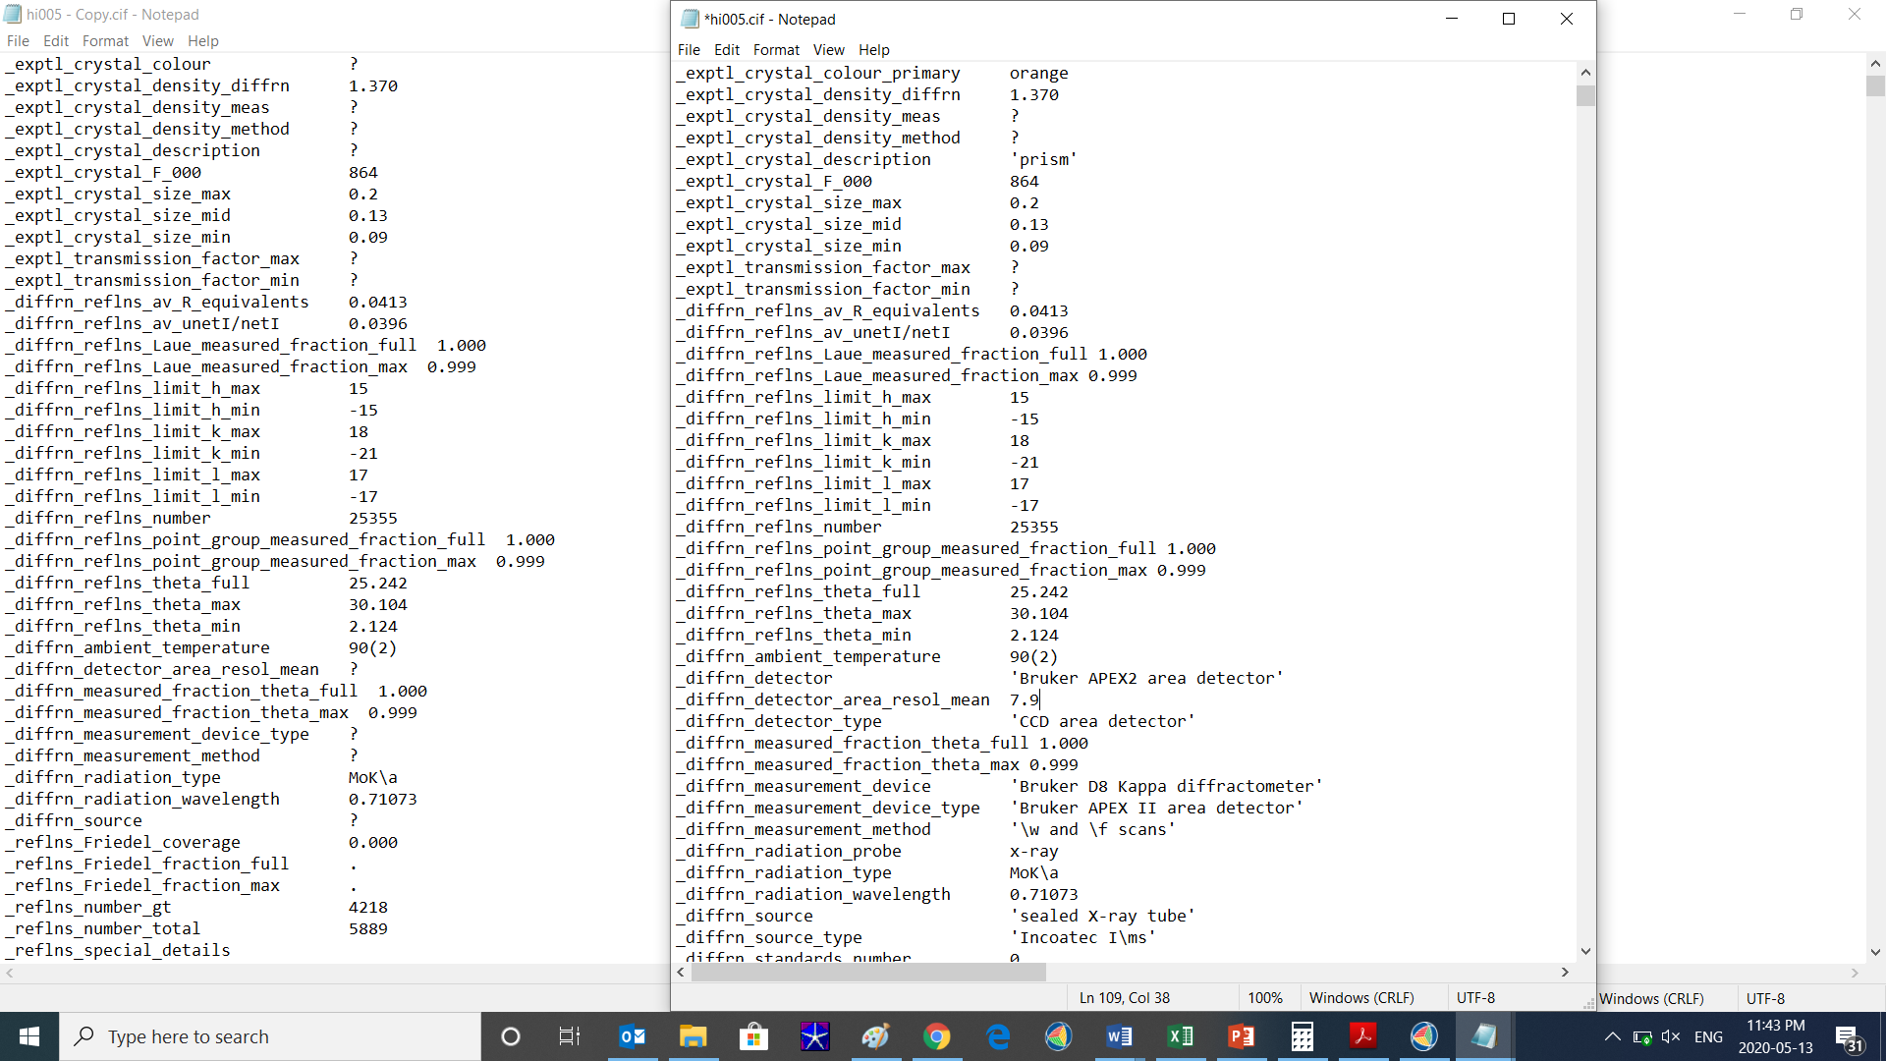
Without files
What information is found in a CIF?
With files
Olex2 will populate fields that describe the crystal, the instrument, etc., from information culled from vendor output files.

Slide 18
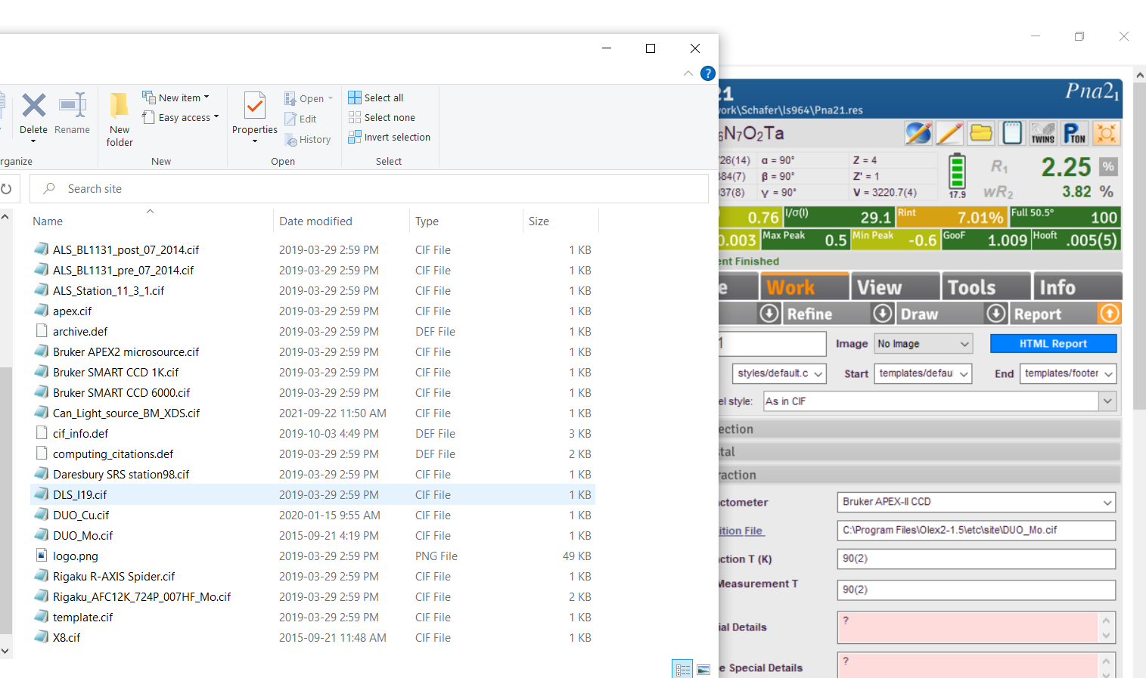

Slide 19
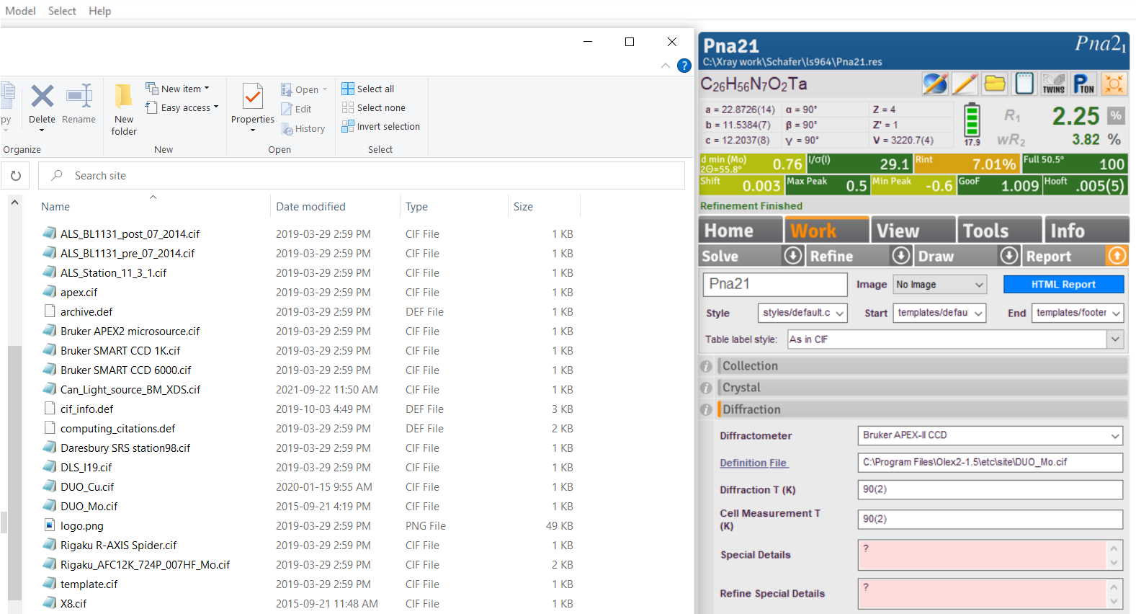

Slide 20
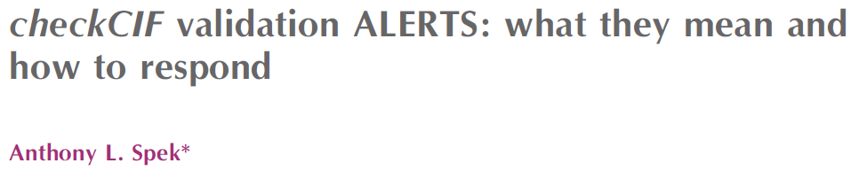
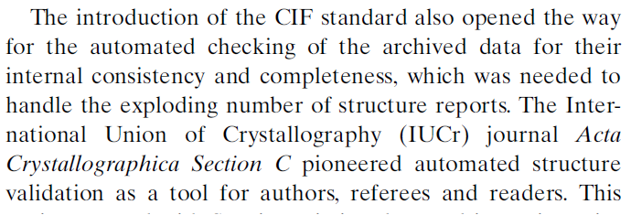
Structure validation / checkCIF
Acta Cryst. (2020). E76, 1-11

Slide 21
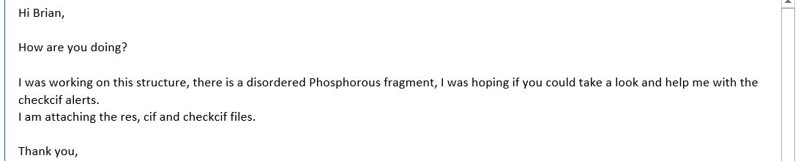
CheckCIF/Structure validation

Slide 22
CheckCIF/Structure validation
CheckCIF:
Reads the CIF and performs a myriad of tests (>500) to assess the validity of the structure. These include, but are not limited to, tests for missed symmetry, missed twinning, solvent accessible voids, and mis-assigned atom types.
Accessible via the checkCIF website (checkcif.iucr.org) as well as via a stand-alone version available via PLATON.

Slide 23
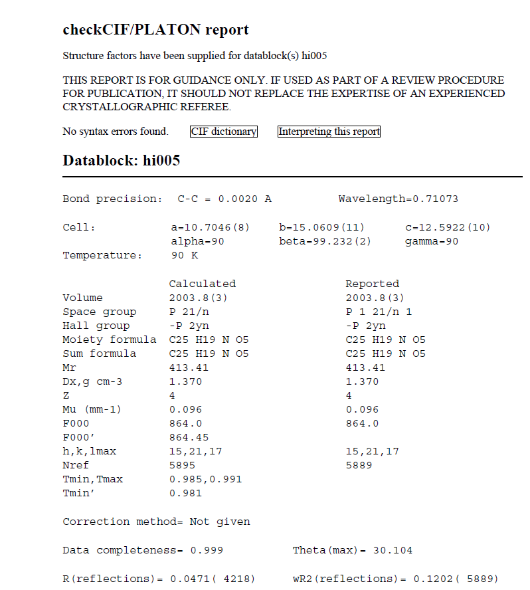
Embedded links!!
CheckCIF/Structure validation

Slide 24
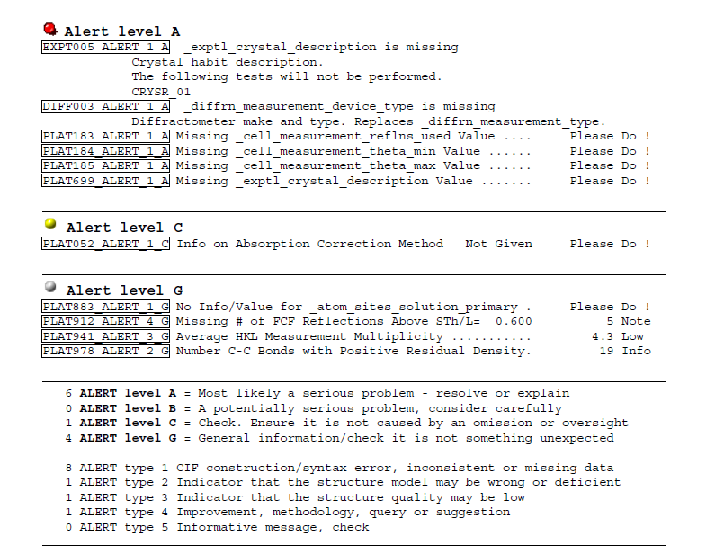
CheckCIF/Structure validation

Slide 25
CheckCIF/Structure validation
Generates “…a report consisting of a list of ALERTS, with associated A, B and C levels of importance, for issues that needed to be addressed. It should be clear the ALERTS are not necessarily errors. They might also point to interesting feature is a crystal structure … All ALERTS should be checked by the authors: a set of lower-level ALERTS may in combination point to a serious issue that needs to be addressed.”
While all ALERTS need to be addressed or at least considered, that does not mean that they have to be eliminated (although that is the best outcome). The Validation Response Form (vrf) is used to respond to each ALERT.

Slide 26
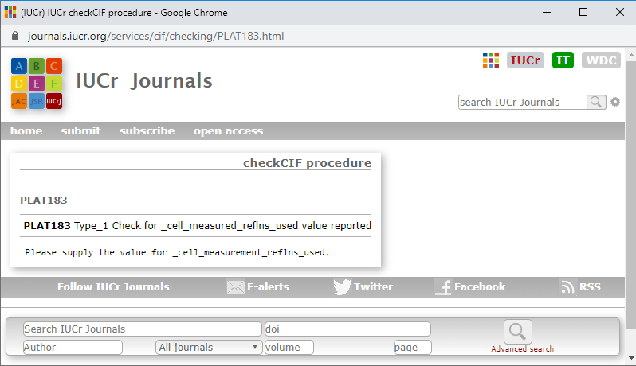
CheckCIF/Structure validation
More embedded links!!

Slide 27

Validation Response Forms
CheckCIF/Structure validation

Slide 28
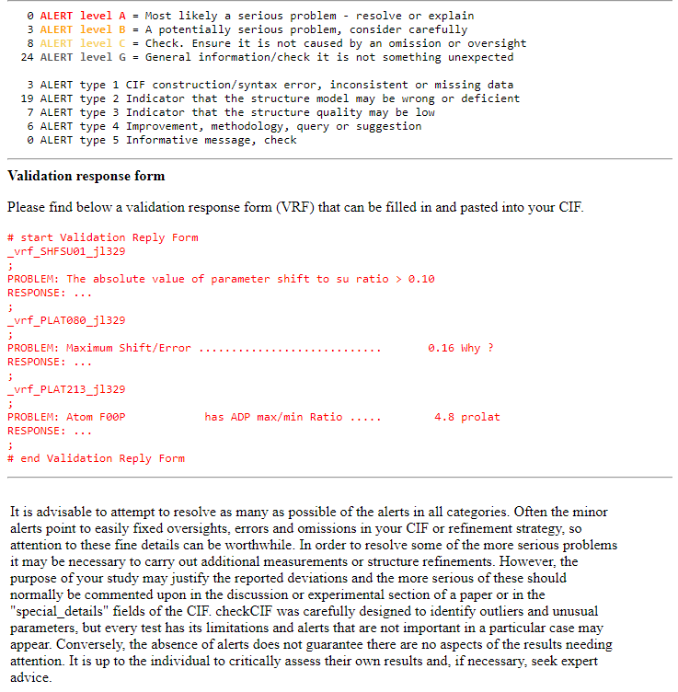
Validation Response Forms
CheckCIF/Structure validation
Cut-and-paste the vrf into your CIF, edit in your own response at the ‘…’, save and re-submit to checkCIF.org. Your new report will include your responses.

Slide 29
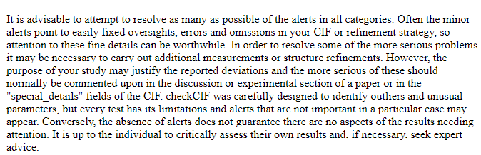
Validation Response Forms
CheckCIF/Structure validation

Slide 30
Validation Response Forms
CheckCIF/Structure validation

Slide 31
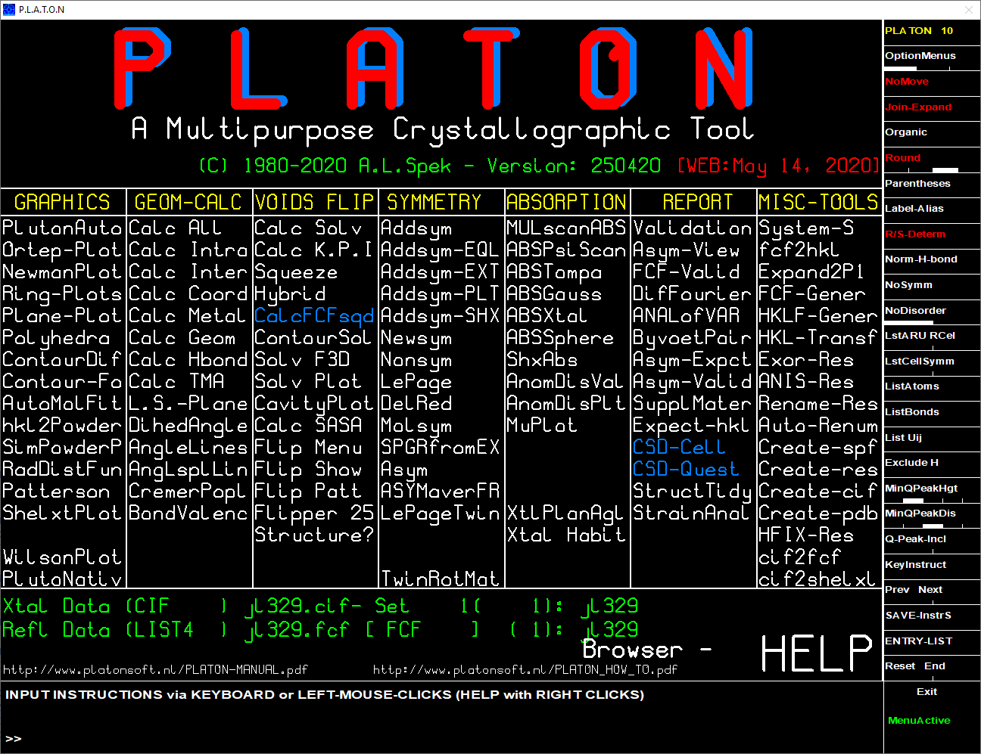
Can access checkCIF from PLATON directly

Slide 32
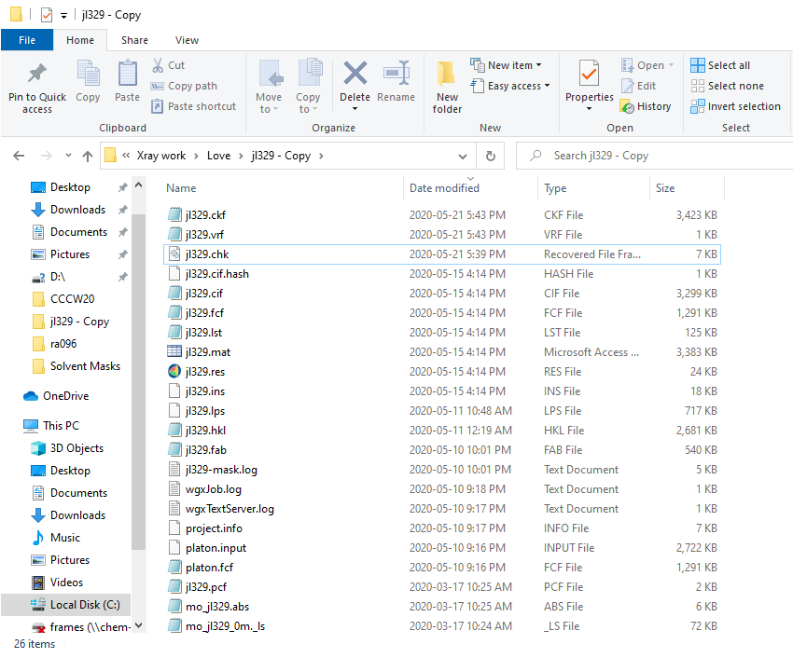
Text version of your validation response form

Slide 33
Text version of your validation response form
Text version of your checkCIF report

Slide 34
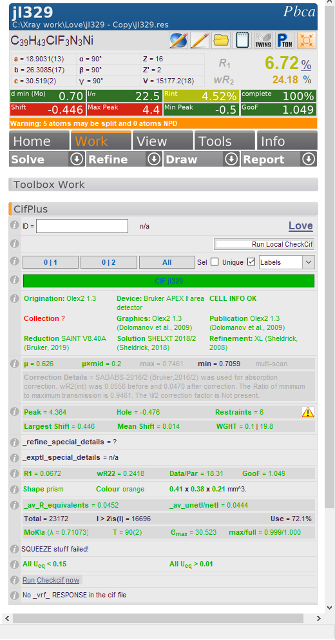
CheckCIF/Structure validation
Run checkCIF from PLATON
Olex2 extension module CifPlus

Slide 35
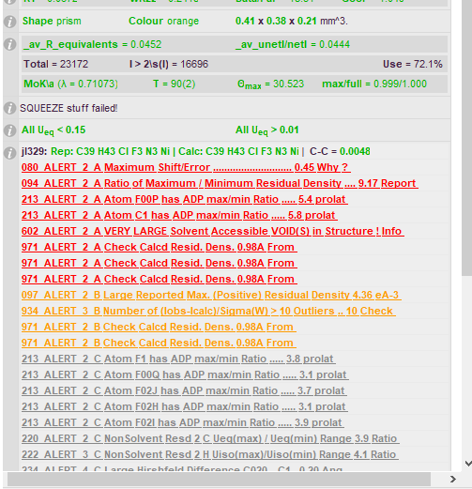
CheckCIF/Structure validation
CifPlus
Click to edit directly into vrf!

Slide 36
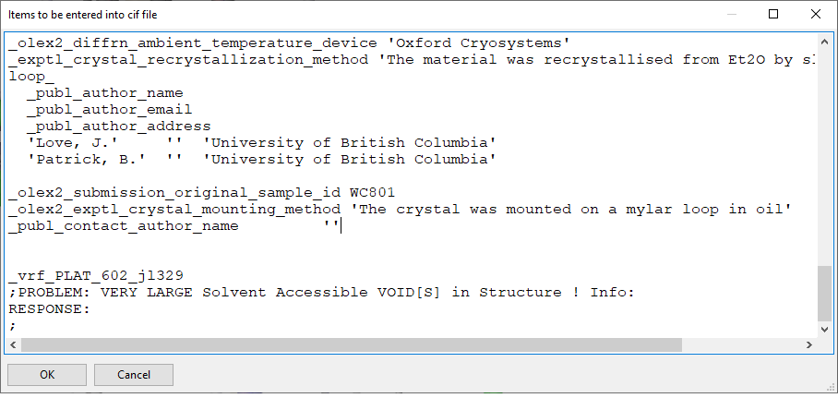
CheckCIF/Structure validation
Validation Response Forms

Slide 37
CheckCIF/Structure validation
Validation Response Forms
The ‘_’ is PLAT_620 is a syntax error! Horst is working on resolving this.

Slide 38
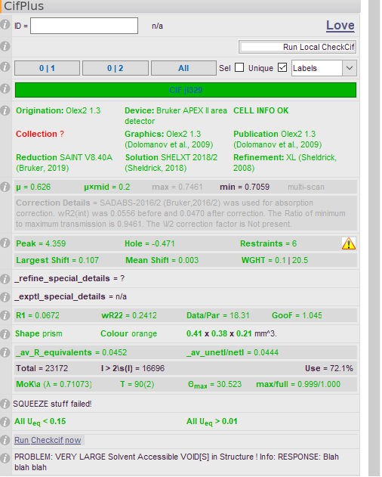
CheckCIF/Structure validation
Validation Response Forms
Recorded response remains with CIF throughout.

Slide 39
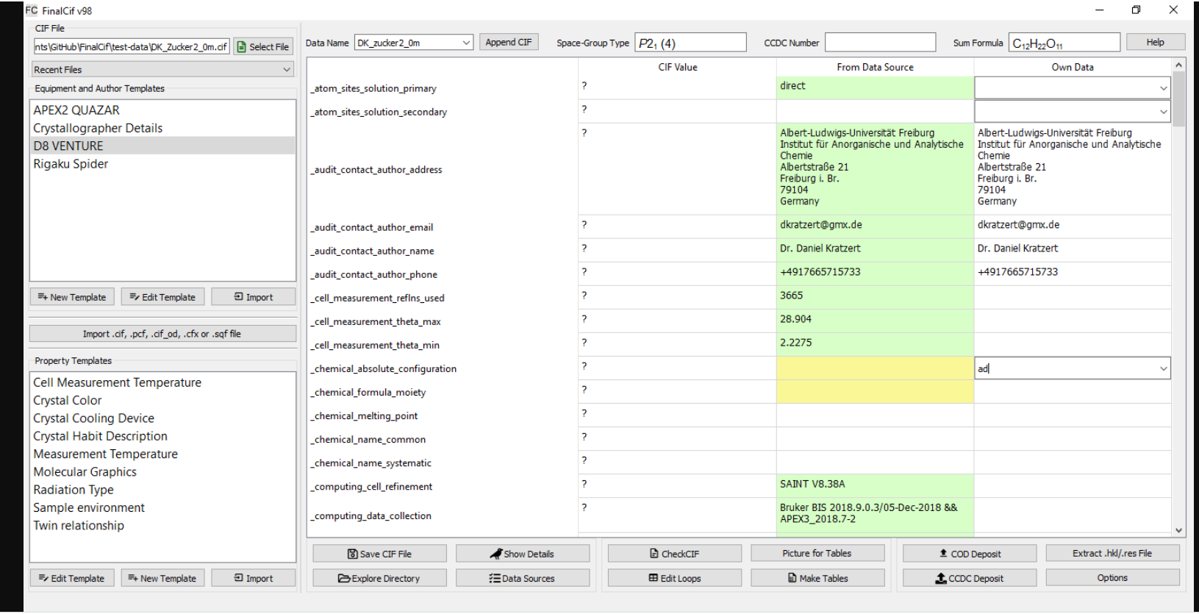
New CIF editor – FinalCif
https://dkratzert.de/finalcif.html

